Slide 1
Secure Data Hiding in Image Using Steganography
CAPSTONE PROJECT
Presented By:
Student Name : Rahul K M
College Name & Department : Institute of Engineering & Technology,
Alwar ( Rajasthan Technical University,
Kota ) / Computer Science and Engineering

Slide 2
OUTLINE
Problem Statement
Technology used
Wow factor
End users
Result
Conclusion
Git-hub Link
Future scope

Slide 3
Problem Statement
The digital age has witnessed an exponential increase in data transmission, raising significant concerns about data security and privacy. While cryptography focuses on encrypting data, steganography aims to conceal the very existence of data within other media. This project addresses the need for a practical and demonstrative tool to illustrate the principles of image steganography, specifically employing the Least Significant Bit (LSB) method. The current challenge lies in providing a user-friendly application that effectively demonstrates:
The process of embedding hidden messages within digital images using the LSB technique.
The ability to accurately extract those hidden messages without noticeable degradation of the cover image.
Practical Application: Emphasizes the need for a working application.

Slide 4
Technology used
Programming Language Used : Python version 3.8 and above
Libraries used :
Platform :
OpenCV - for image read and write and image to NumPy ndarray matrix for bit manipulation
Tkinter – for GUI Elements like buttons, input box, text box etc.
CustomTkinter - Python UI library that builds upon Tkinter, offers a more modern and customizable look for desktop applications
PIL – (optional) for application decorative Image display
OS – for operating system support for file read and write within python application
Time – (optional) for application simulated delayed effects
Threading – for application parallel background file processing.
OS ( Windows 10 and above or Linux )
at least 4GB of RAM
any modern processor or microcontroller with clock speed of 1GHz or higher
for optimal functioning system HDD requirement at least 50 GB.
IDE : python supported IDE ( Spyder used for this project ) or command-line (PowerShell or Terminal)

Slide 5
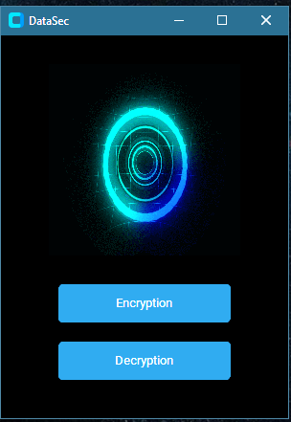
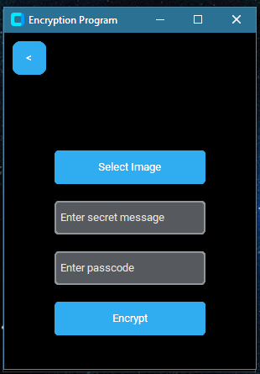
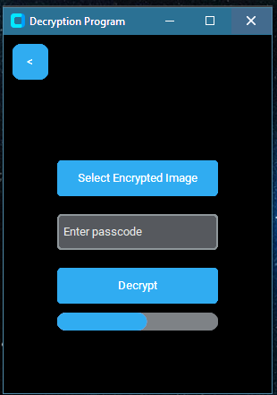
Wow factors
This project delivers a 'wow' factor through its elegant, intuitive GUI. Experience seamless navigation and control with minimal resource usage. The application demonstrates that powerful functionality can be achieved with a simple, visually appealing design, proving that efficiency and user-friendliness can coexist beautifully. Key highlights: intuitive interface, minimal resource consumption, and streamlined design.

Slide 6
End users
This application empowers individuals concerned with digital privacy, allowing them to discreetly share sensitive information within seemingly innocuous images.
Students and educators can utilize this tool to explore and understand the principles of steganography in a practical, hands-on manner.
Hobbyists and developers interested in digital security and image processing will find this application a valuable resource for experimentation and learning.
Anyone seeking a simple and effective method for concealing data within images can benefit from the application's user-friendly interface.

Slide 7
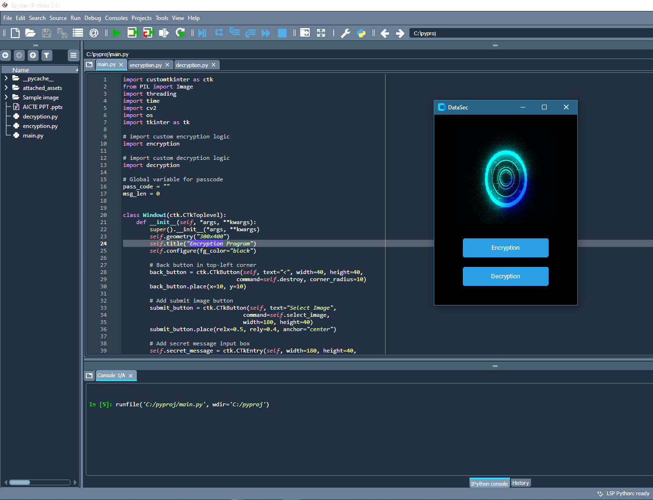
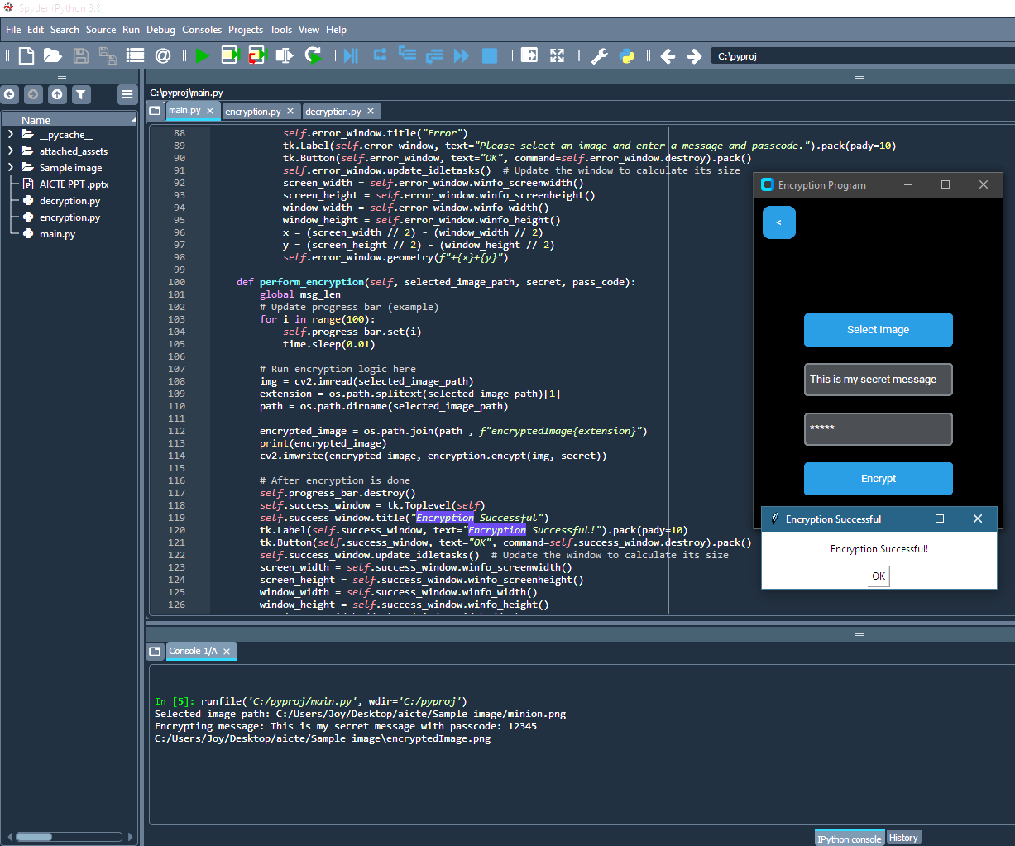
Results
Click – opens encryption window
The application, launched via command line or IDE, presents a simple GUI. In the encryption window users encrypt by selecting an image, entering a message and passcode, and clicking 'Encrypt’. A progress bar tracks the process, culminating in a success message and the file is saved exactly where the original image was selected.

Slide 8
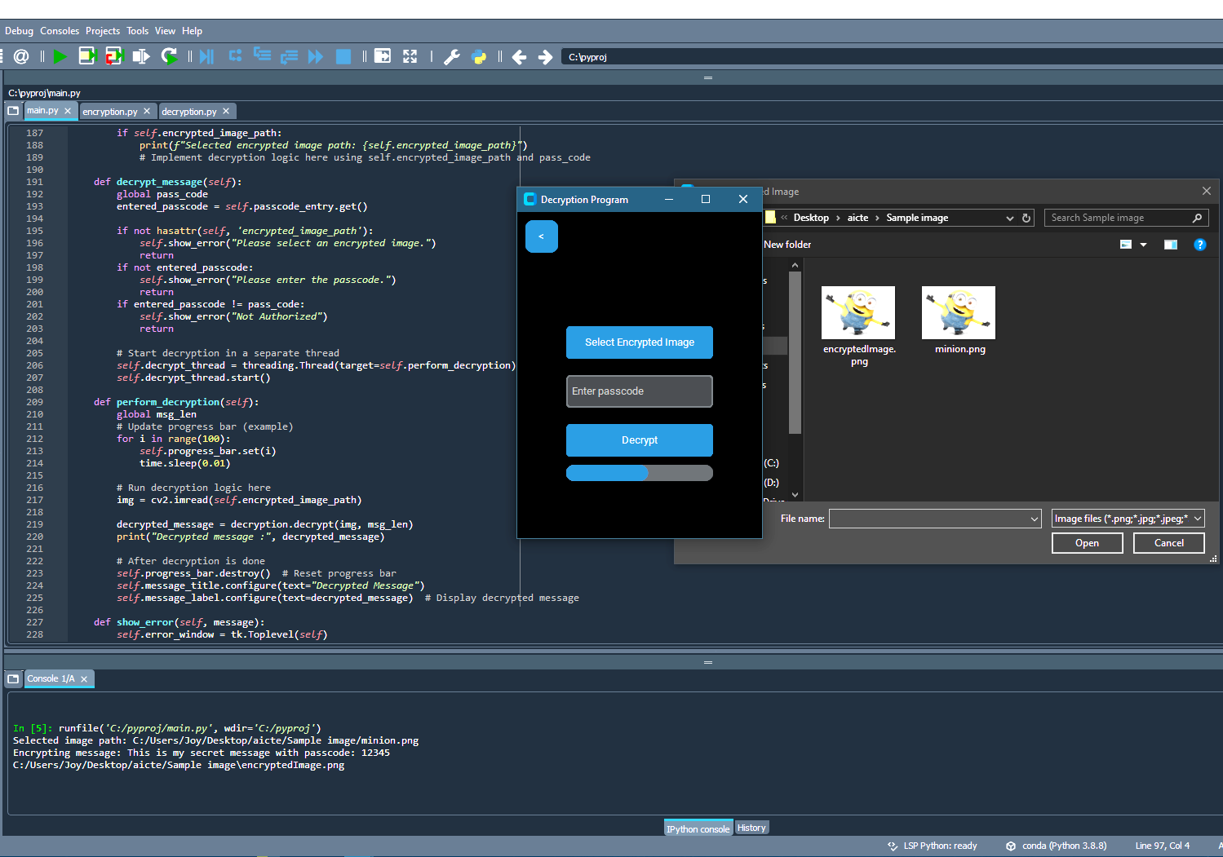
Results
Click – opens decryption window
Clicking “Decryption” button opens up decryption program window where user can input the encrypted image to extract the message from. Input the passcode entered during encryption and click decrypt button to execute, the extracted message will show up after the process is completed.

Slide 9
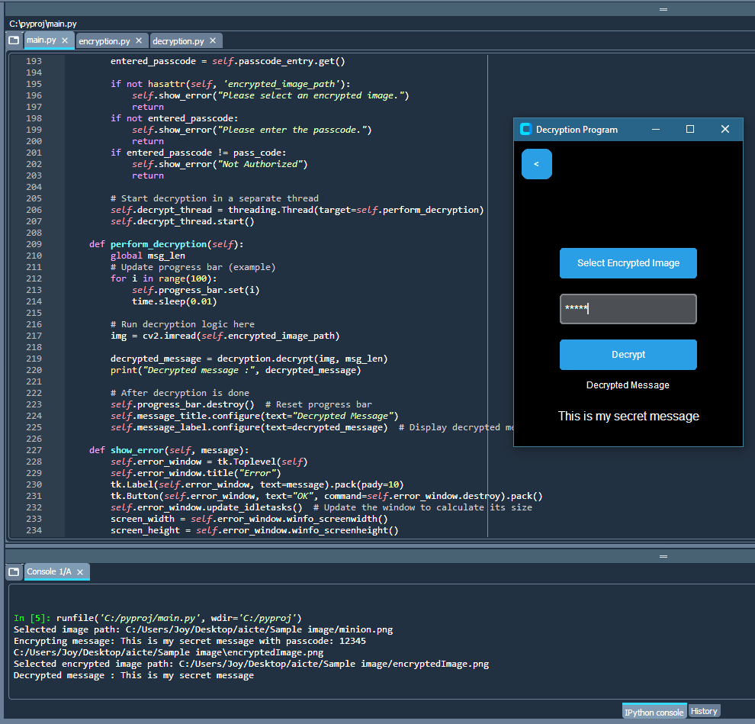
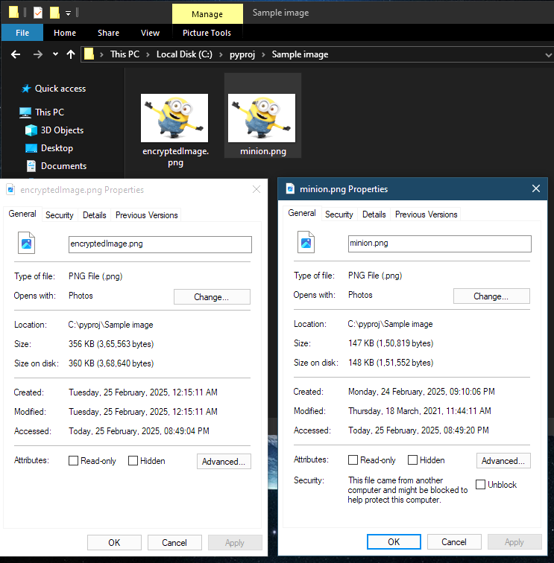
Results

Slide 10
Conclusion
This project successfully developed a user-friendly application demonstrating the Least Significant Bit (LSB) method of image steganography. The application effectively conceals and retrieves hidden messages within images, showcasing the practicality of this technique for data concealment. By providing a simple and accessible interface, this project serves as a valuable tool for understanding and exploring the principles of steganography

Slide 11
GitHub Link
https://github.com/rkm-dev/AICTE-B4-Internship-Steganography.git

Slide 12
Future scope(optional)
The development of this LSB steganography application serves as a practical educational tool, illustrating the core concepts of data concealment within digital images. The project demonstrates the viability of this technique and lays a foundation for potential future enhancements, such as incorporating more advanced steganographic algorithms or expanding platform compatibility.

Slide 13
THANK YOU

